Slide 1
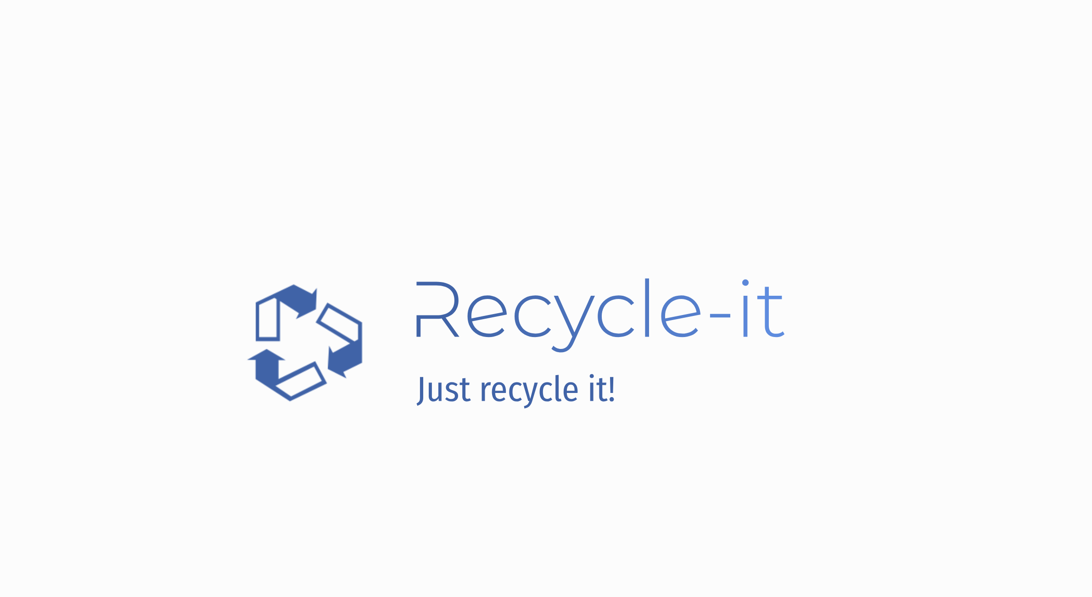
By: the-hackman

Slide 2
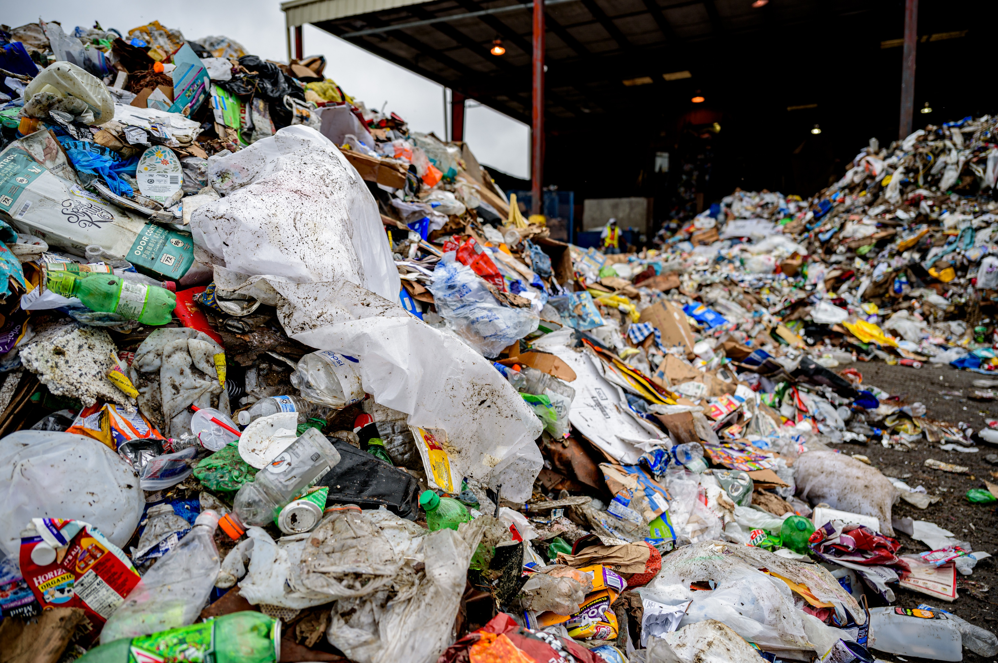
Recyclable?
or
Wastes?
Public Domain Image
Notes:
This photo was taken from a recycling depot. How much of it do you think can be recycled?

Slide 3
Recycling Contamination
In the photo, are the recyclable items that have been contaminated and cannot be recovered.
In Edmonton, about 25% of the total recyclables collected end their cycle prematurely and get thrown away.

Slide 4
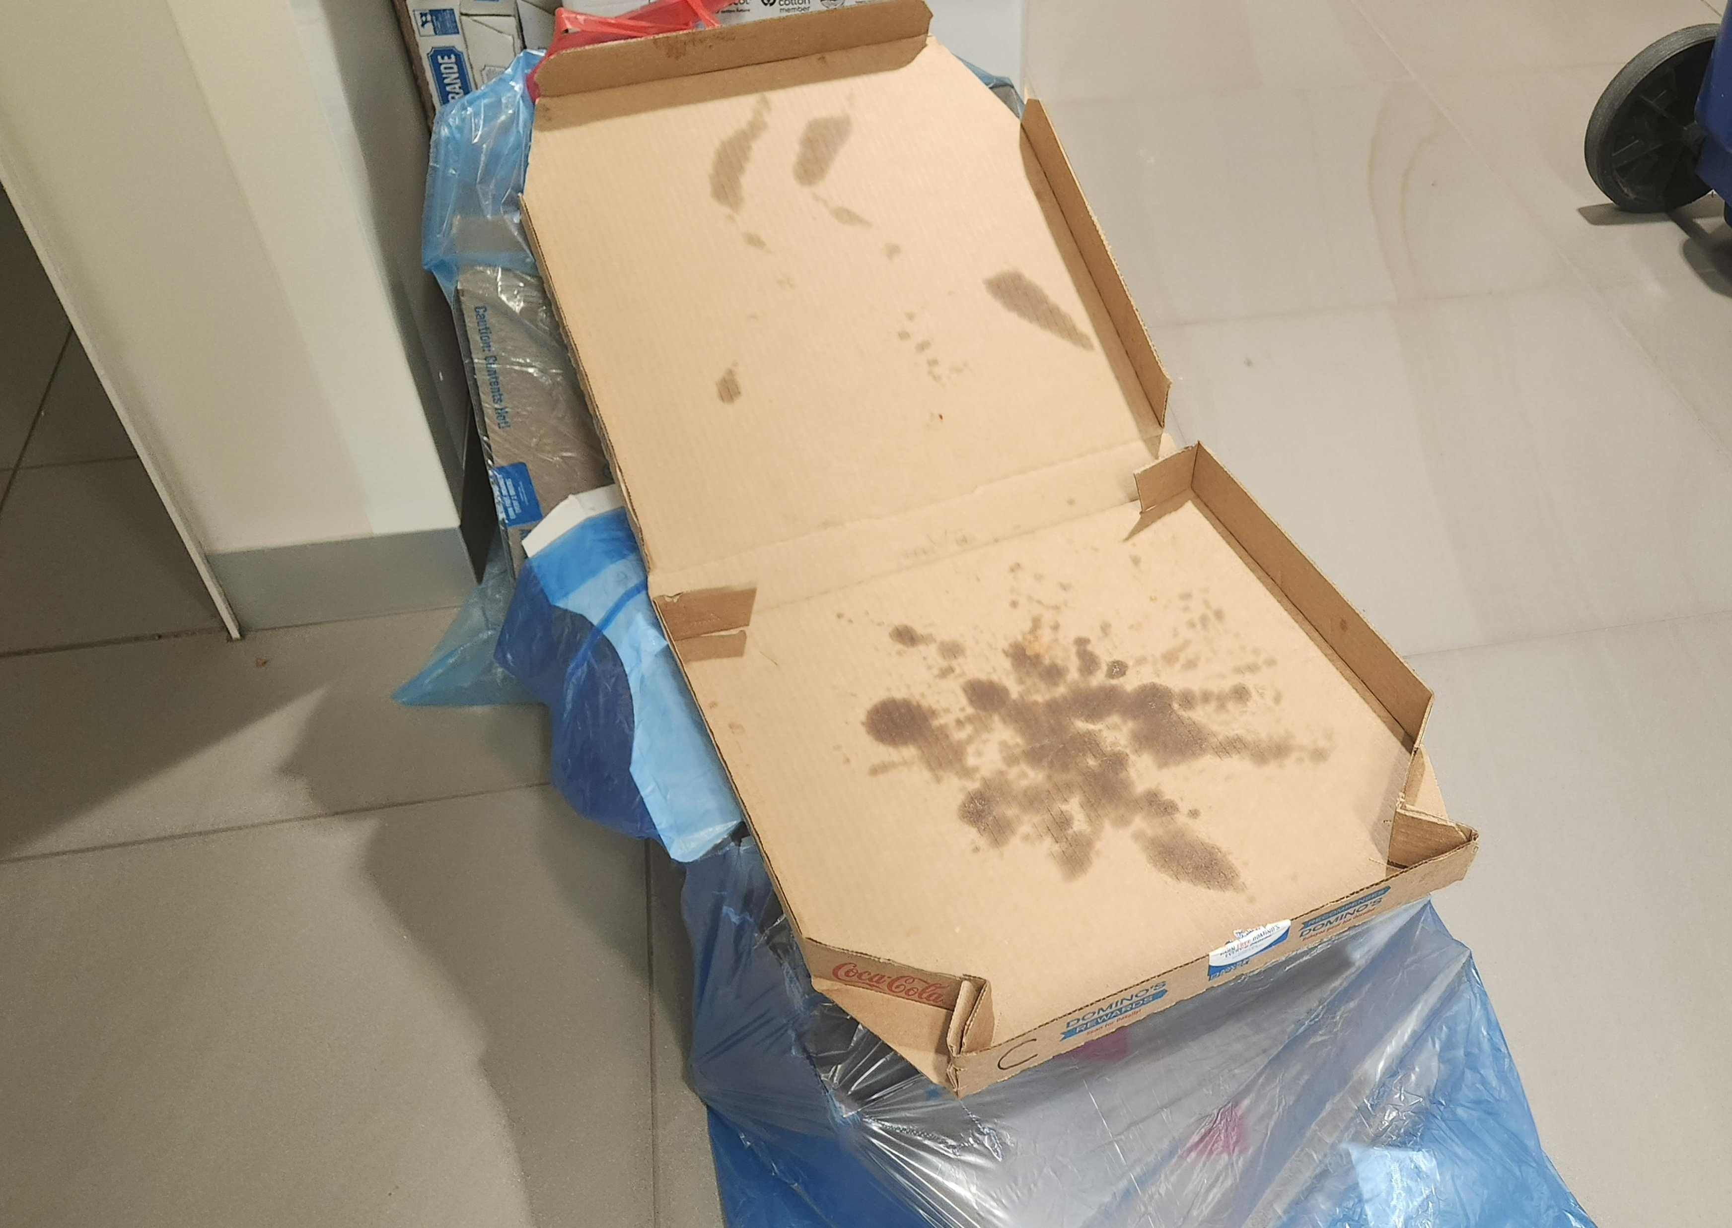
Lead Contamination Factors
Wrong plastics/plastic bags Vinyl (#3)
HDPE bags are accepted (Stretchy)
Food scraps/unrinsed bottles
Grease spots are ok
Loose Shredded Paper
Must be bagged in a clear plastic bag.
Aspirational Recycling

Slide 5
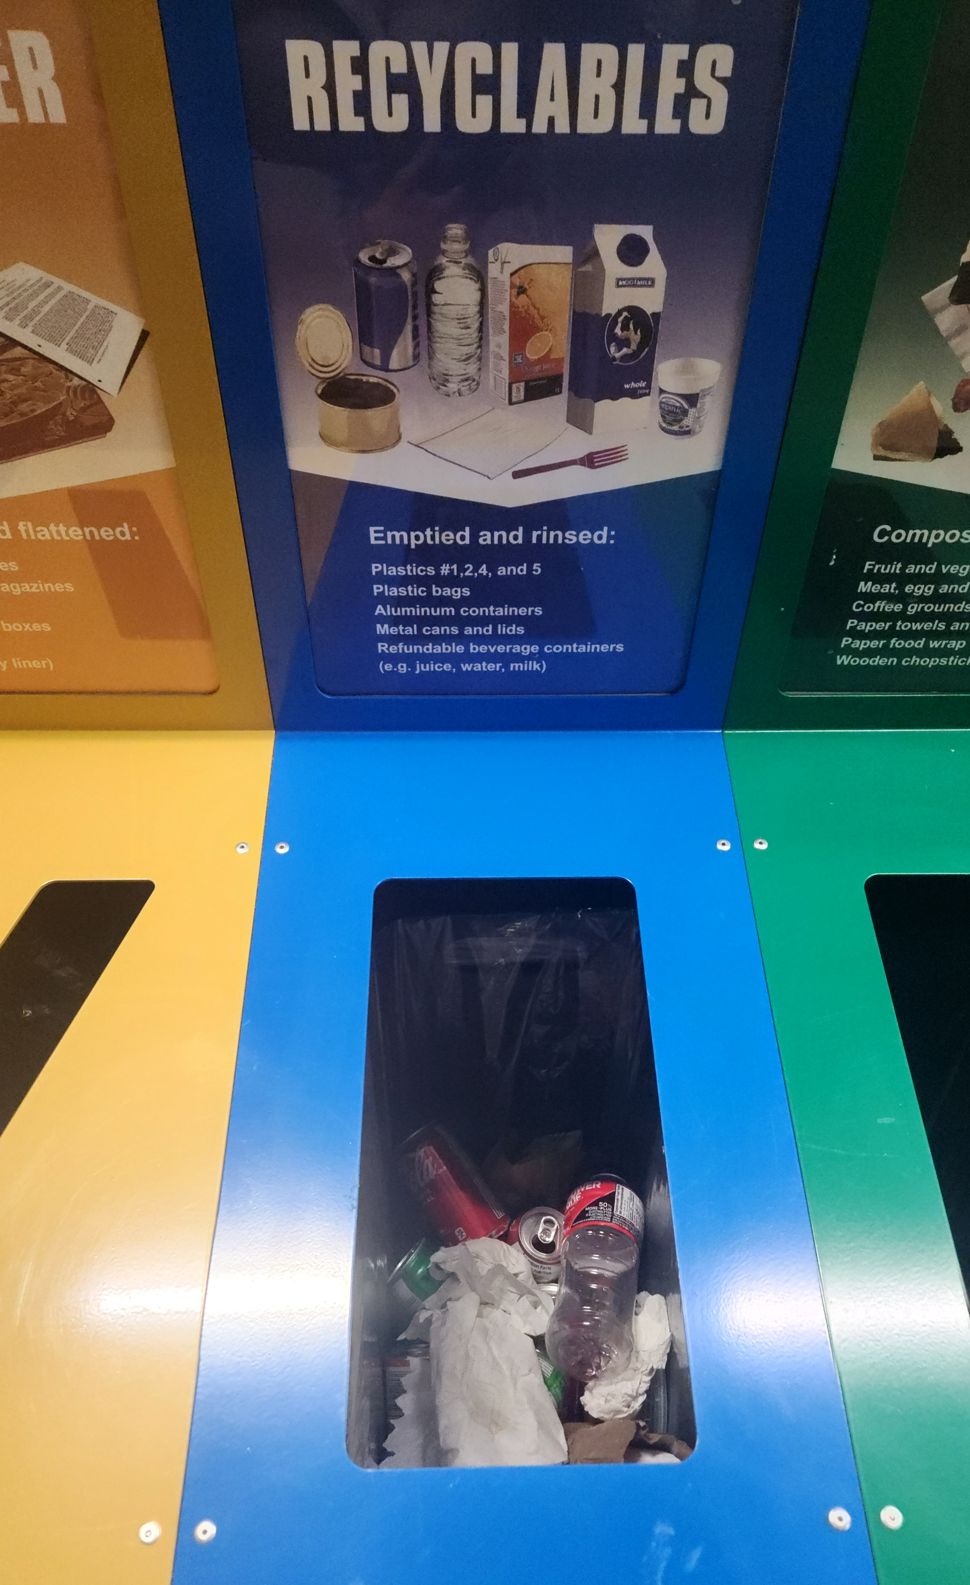
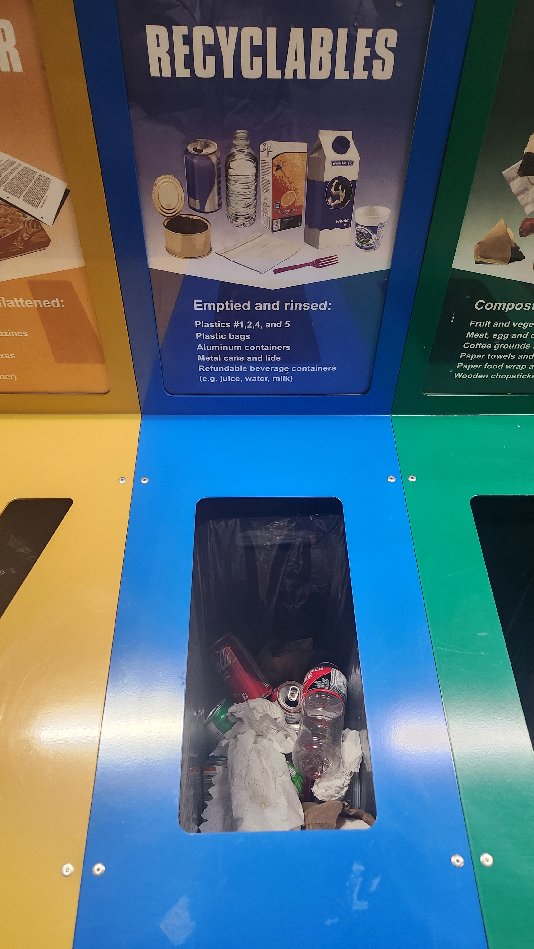
How is University of Alberta performing?
Notes:
This is a photo I took last night in the DICE after the dinner, there obviously are non-recyclable wastes and recyclables that are not properly disposed.

Slide 6
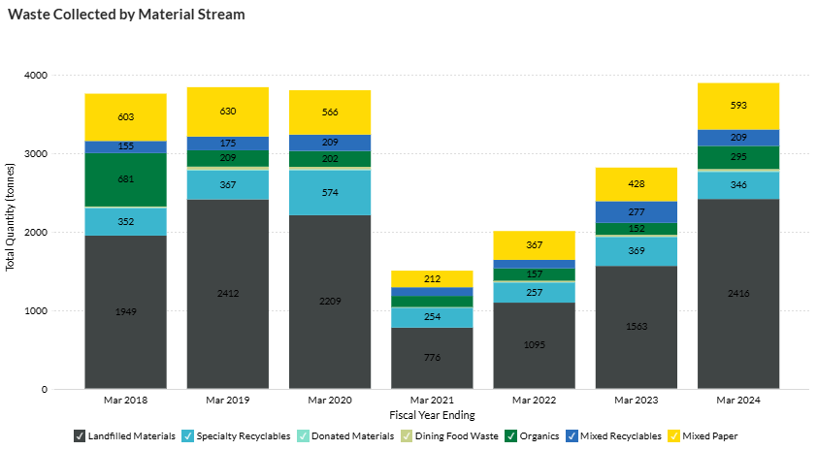
Waste Diversion Data provided by University of Alberta homepage
Recyclables collected approximates at around 555 tonnes/year.
This will equate to about 140 tonnes that are not recovered for recycling

Slide 7
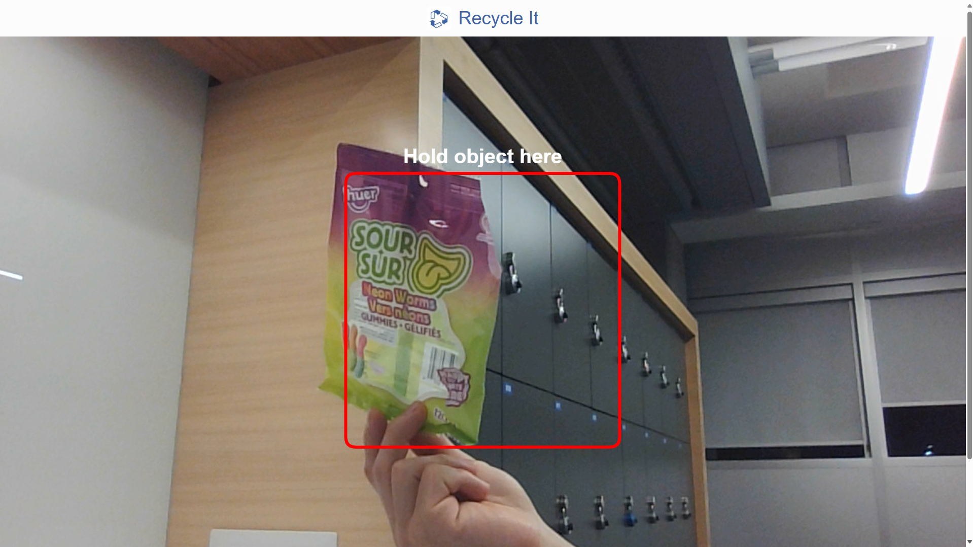
Machine Learning powered solution to provide engaging experience recycling with minimal effort input from the user.
Anywhere, anytime, by anyone. The software is easily accessible to provide everyone to make positive impact.
Cheap and informative, the access is free, and it is easy to manufacture.
Processing speed is fast and is not time-consuming.
PlaceHolder for the Pic

Slide 8
How much profit is projected to be returned?
One percent reduction in recycling contamination can cut the cost of recycling in Toronto by $600,000 to $1,000,000-Jim McKay, general manager of waste management services for City of Toronto
Note that this does not account for any capital surplus from the prevention of devaluing of material and eco-cost associated with environmental impact assessment

Slide 9
Interested in Sponsorship/Collaboration?

